Slide 1

CoderDojo
Scratch Beginners
Code and notes by permission Michael Madden, 2012

Slide 2
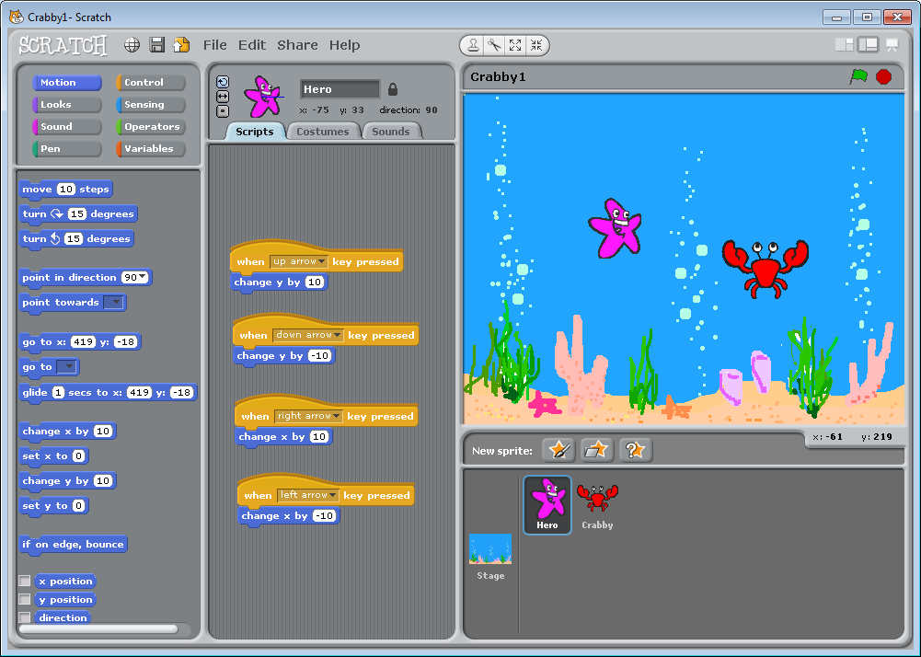
Today's Challenge: Write Your First Computer Game!

Slide 3
Today's Big Ideas
What is Coding?
Who Writes Code?
What is Scratch?
How Can We Write Code?

Slide 4
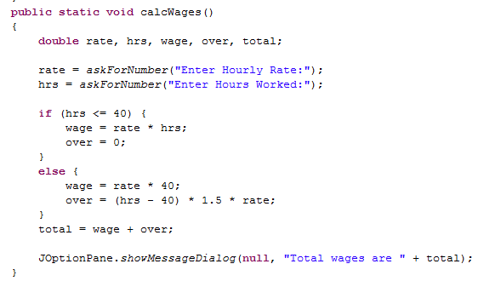
Programming Languages
Tell computer how to perform tasks
C, C++, Java, Visual Basic, Python, JavaScript, PHP, HTML5
Some Java Code

Slide 5
Programming Languages
Input, Output & Store Data
Operate on Data
E.g. text, numbers
E.g. add numbers, change text
Loops
Repeat commands several times
Decisions
Do something IF something else is true

Slide 6
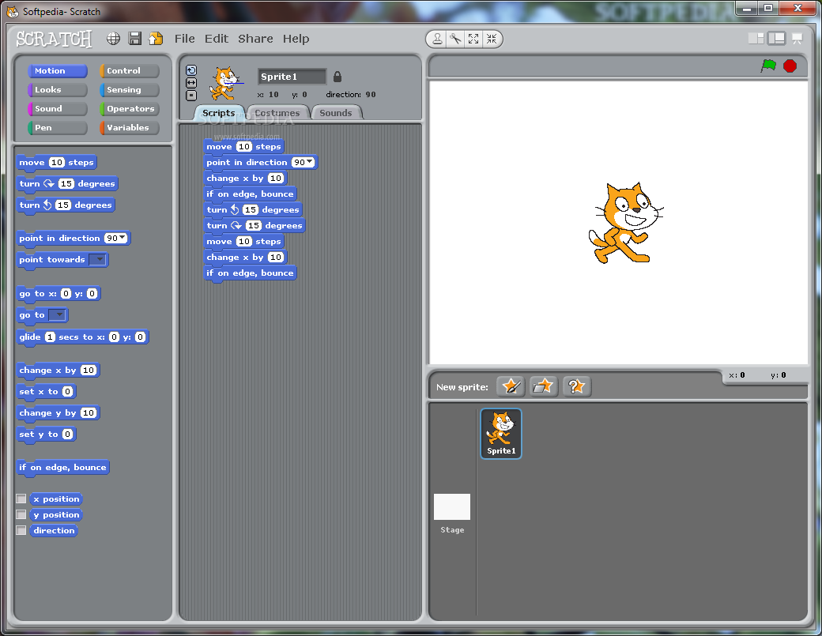
Scratch http://scratch.mit.edu
Free & Open Source
Windows, Linux, Mac
Palette of Commands
Games & Animation
Encourages Sharing
Install it now!

Slide 7
Scratch's Interface
START & STOP
Main Menu
Toolbar
Scripts/Costumes/Sounds
STAGE
Palette of
COMMANDS
SPRITES
SCRIPTS
for Sprites

Slide 8
What Can You Do With Scratch?
Animations
Quizzes
Arcade Games
Web Games
It's Up To You!
Let's look at some examples …

Slide 9
Our First Game: Patrick v. Krabby

Slide 10
How to Get Started
Plan the Design
Create First Character
Think first!
Design it: appearance & behaviours
Test It
Any bugs? (Not working as expected)
Extend It
More Characters, More Behaviours, More Testing!
Start simple: add more later
Write script (Code) to control its behaviours
Debug and Improve

Slide 11
How to Make Progress
Our Creative Coding Rule: There's More Than One Way to Do It!
Try things out and iterate
Save copies: go back if it doesn't work
Talk to others, share ideas, learn from their ideas, improve on their ideas!
Examine other people's code on the Scratch website & upload your code

Slide 12
Steps To Make Our Game
Create Patrick: what will he look like?
Code to control him with arrow keys
Create Krabby
Code to make him move randomly
Make things happen when Krabby touches Patrick
Add variable for Lives
End game when Patrick has 0 lives
Change the Stage: Choose a background

Slide 13
Interactive demo of these steps in Scratch …
Final version: http://scratch.mit.edu/projects/emcdojo/3096083

Slide 14

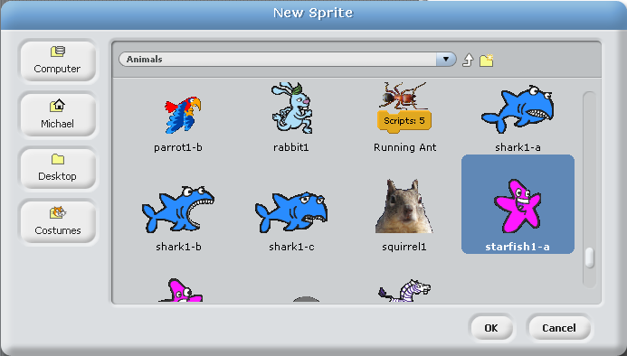

Create a Sprite
New Sprite: Select from existing designs
Tip: Default size is big relative to stage: this shrinks it
Name him:

Slide 15

Make it Move Under Your Control
Now figure out how to make it respond to the other arrow keys …
y
x

Slide 16

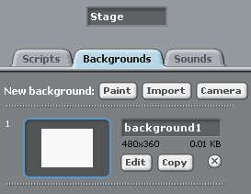
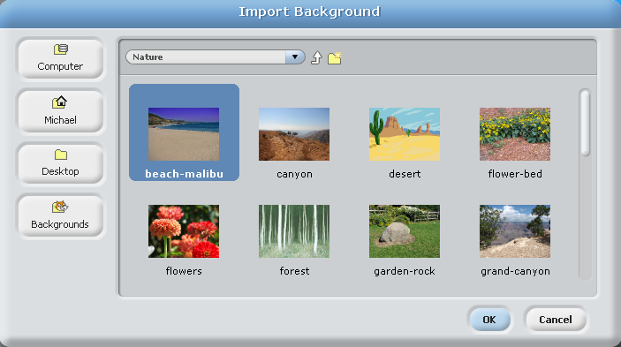
Change the Background
Choose one to suit your own game's theme

Slide 17

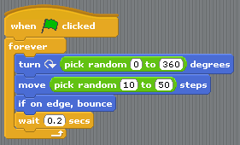
Create Another Sprite that Moves at Random

Slide 18

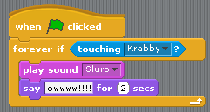
Make Things Happen When They Touch

Slide 19
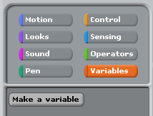
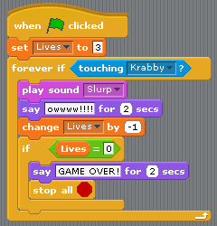
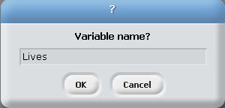
Keep Track of Lives

Slide 20
More Things to Try …
Make a second bad guy that you have to keep away from, and that moves in a different way. Hint: Duplicate first bad guy, then import a different costume for it, and change its script so that it moves in a different way. For example, you could make him point in a random direction (in range 1-360) when the flag is clicked, and after that just keep moving some steps, and bounce if on the edge. You might have to update the code for lives, too.
Add some treasure that will give you extra lives. Hint: Add a sprite that looks like treasure. Don't add code to make it move, but do add code so that if the good guy touches it, it changes LIFE by 1 and plays a happy noise. After you have tested it and made sure it works, duplicate it.

Slide 21
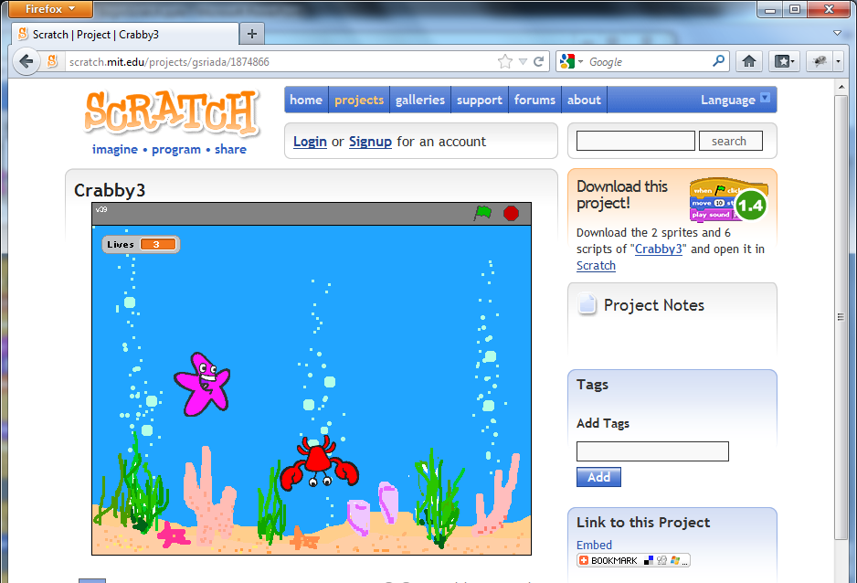
At the End …
Upload your project to the Scratch Website user: emcdojo password: cork123
Access it
from home
Improve it
Show your
friends!

Slide 22
CoderDojoIrelandCOE@emc.com

